Slide 1
A Study of the Effects of Co-Locating DV Advocates in Child Protective Services Offices: The New York Experience
May 1, 2014
Rose Greene and Ellen Unruh
Notes:
Rose presents slides 1-9

Slide 2
Background
Notes:
Overview of presentation

Slide 3
Background
Research Methods

Slide 4
Background
Research Methods
Findings in Brief

Slide 5
Background
Research Methods
Findings in Brief
Selected Findings

Slide 6
Background
Research Methods
Findings in Brief
Selected Findings
Implications

Slide 7
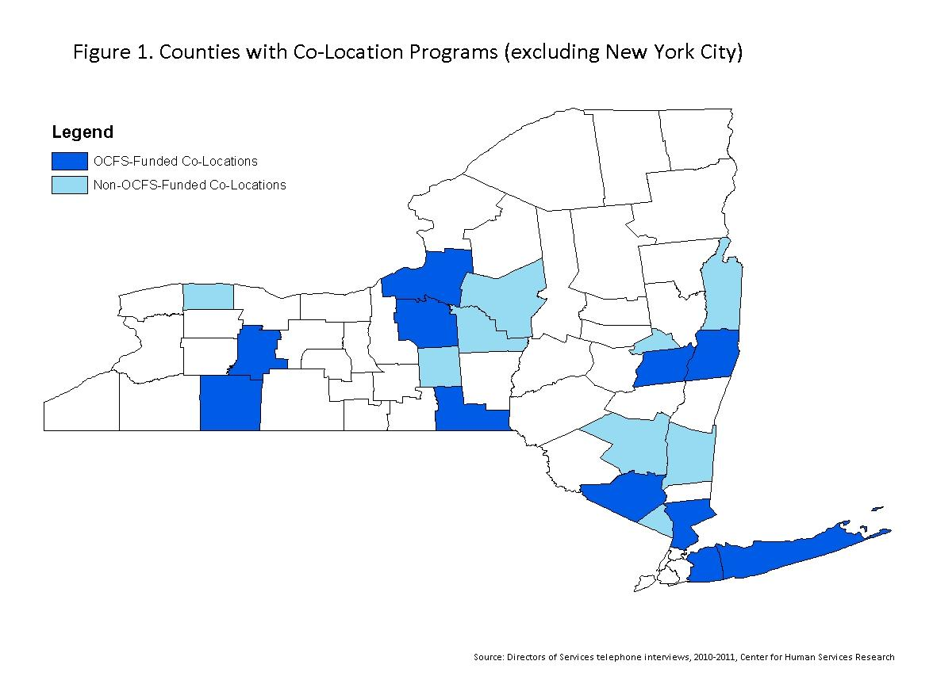
Source: Center for Human Services Research, Director of Services Interviews, 2011
Notes:
We will provide context: who the players were (State, Counties, DV non-profits, and evaluator) and location of sites
The NYS experience: recognizing the significant overlap in families served by the DV and Child Welfare system, the NYS Office of Children and Family Services supported many initiatives to foster the exchange of information between systems. This included a competitive grant process to support a co-location model in which a DV Advocate is physically placed in a CPS office.
Model showed promise so came to CHSR for evaluation
Over time 20 counties have participated in the co-location model, some currently supported by OCFS and others by other sources. Where it was implemented (MAP)
NYS is a state supervised/county administered social services system so there was a lot of site variation

Slide 8
Field interviews and focus groups
Qualitative
Surveys of Workers
Case Record Reviews
Quantitative
Notes:
Methods – stress research rigor and the study stages
Qualitative: field interviews and focus groups (N=335 individuals including CPS caseworkers and supervisors, co-located DV Advocates, and DV agency administrators)
Quantitative: approach was a comparison of counties with co-location and counties without co-location (surveys of 1,121 CPS caseworkers and 458 DV Advocates; and 230 CPS case records)
Limitations: no families

Slide 9

Improvements
Yet….ongoing challenges
Notes:
Findings in Brief
This offers the main findings
Overall the study found that co-location of a DV Advocate in a CPS office
fostered better CPS case practice
improved system relationships
had a positive influence on families
but raised systems issues that will continue to need to be addressed

Slide 10
How Did Co-Location Work?
Location, Location, Location
Notes:
(Ellen presents starting here)
HOW DID CO-LOCATION WORK?
This slide emphasizes that placing a DV Advocate in a CPS Office doesn’t in and of itself produce benefits. Location, referral systems, and agreements about partnerships matter.
Location, Location, Location
Physical proximity matters
Locate advocate in a high traffic area (e.g. by the microwave or bathrooms)
Leads to social integration with caseworkers (invited to office parties, etc.)

Slide 11
How Did Co-Location Work?
Location, Location, Location
Identification and Referral
Notes:
HOW DID CO-LOCATION WORK?
System to process referrals from CPS to the Advocate
how it worked (Flow chart)
why cases weren’t referred

Slide 12
How Did Co-Location Work?
Location, Location, Location
Identification and Referral
Worker Practice
Notes:
HOW DID CO-LOCATION WORK?
Joint practice: case consultation, joint home visits, referring the victim to services, etc.

Slide 13
Effect on CPS worker practice, knowledge and attitudes
Notes:
How did co-location influence CPS caseworker and DV Advocate knowledge, attitudes, and case practice?
CPS workers in co-location counties more often consulted with DV staff about cases
CPS workers more often reported positive communication with DV Advocates (note - Hatfield and McCoys, a reference to a legendary family feud in the South)

Slide 14
CPS Caseworkers
Notes:
How did co-location influence CPS caseworker knowledge, attitudes, and case practice?
CPS workers in co-located counties more often:
helped DV victims identify DV offender behavior patterns, discussed with victims the DV offender’s impact on the children, and spoke with DV offenders about DV and taking responsibility for their actions
Source: case record reviews 107=Co-located 123=Not co-located

Slide 15
DV Advocates more likely to:
Notes:
How did co-location influence DV Advocate knowledge, attitudes, and case practice?
Co-located Advocates were more likely to participate on joint home visits, case conferences and family team meetings
The case conferences and family team meetings were a new joint activity --- emerged as a practice from the communities with co-location
A case conference is a meeting of professionals, often multi-disciplinary, to discuss a case.
A family team meeting brings together the family, their support systems, and professionals to discuss the family’s plan with CPS.

Slide 16
DV Advocates
Know enough about the CPS process to help clients through it
Notes:
Co-located advocates had a greater understanding of CPS
Co-located advocates more likely to report positive experiences with CPS
More likely to talk with their clients not only about keeping themselves safe, but also talk with their clients about keeping their children safe

Slide 17

What effect did this have on families?
Notes:
What effect did this have on families?
--More services; Less victim-blaming language; Greater Client engagement
Findings at the case level
More services - more likely for both DV victims and DV offenders to be referred to community-based services
More sensitive practice: Reduced use of victim blaming language by caseworkers with clients that directly or indirectly blamed a DV victim for the offender’s violence
Examples of responses that directly or indirectly blamed a DV victim for the aggressor’s violence:
DV “between” parents, rather than placing responsibility for violence on the aggressor/ “parents engage in DV”
A DV victim’s “failure to protect” children from violence directed toward the adult
Threats of CPS consequences if a DV victim does not “avoid DV”
Criticism of a DV victim for returning to the DV offender
Minimization of the presence of DV (i.e. “it was only one slap”)

Slide 18
46%
Case notes
less likely to include victim-blaming language
29%
Not
Co-Located
Co-Located
Notes:
Reduced use of victim blaming language by caseworkers with clients that directly or indirectly blamed a DV victim for the offender’s violence, both in interviews with clients, as well as in the case notes used to explain case determinations

Slide 19
Client Engagement
Clients are open to DV advocate since she does not carry the threat of child removal
DV advocates help translate CPS process to clients
CPS can act as a buffer for receiving DV services
Notes:
What effect did this have on families?
Co-location promoted greater engagement
CPS may carry stigma in some communities, making it difficult to caseworkers to build trust with clients. Caseworkers felt clients were more open to addressing DV issues with DV advocate during the investigative process since she does not carry the threat of child removal
DV advocates help translate CPS process to clients
--Viewing DV advocates’ positive regard of CPS helped client to trust CPS
--DV advocates encourage clients to share info with CPS
CPS can act as a buffer for receiving DV services. For example, clients could tell the DV offender, “I have to go to counseling – CPS told me to.” Some DV victims could access DV advocates more discreetly at the DSS office by informing the perpetrator that she needed to attend a CPS appointment rather than a meeting with the DV advocate.

Slide 20
123 cases
107 cases
Notes:
Victim substantiation: Reports from co-location were significantly less likely to cite DV as the only reason for substantiation of DV victims
Overall, no difference in overall substantiation rates or child removals (rare occurrence)

Slide 21

Challenges
Information Sharing
Notes:
What are the Challenges to collaborative practice?
Information sharing

Slide 22

Challenges
Information Sharing
Perpetrator Programs
Notes:
What are the Challenges to collaborative practice?
Perpetrator programs

Slide 23

Challenges
Information Sharing
Perpetrator Programs
Target Population
Notes:
What are the Challenges to collaborative practice?
Target population

Slide 24
Recommendations
Expand and replicate the co-location program
Notes:
Implications/Best Practice/Recommendations
Overall: Our study underscores the fact that child welfare’s recognition of domestic violence as a specific circumstance that requires specialized intervention is warranted, and that the co-location model is worthwhile
Suggestions to improve the co-location program: tighten up the referral process by standardizing referrals, making them universal for all cases with DV; strongly encourage – or even require – caseworkers to involve the DV Advocate in every instance where DV may be “mild” or suspected; this includes the practice of joint home visiting – don’t reserve this practice for only the “serious” DV cases; refine information sharing protocols
Unmet Needs: programs for perpetrators, more services focused on male DV victims and DV victims for whom English is not their primary language.

Slide 25
Recommendations
Expand and replicate the co-location program
Support continuous quality improvement of the co-location model
Notes:
Implications/Best Practice/Recommendations
Overall: Our study underscores the fact that child welfare’s recognition of domestic violence as a specific circumstance that requires specialized intervention is warranted, and that the co-location model is worthwhile
Suggestions to improve the co-location program: tighten up the referral process by standardizing referrals, making them universal for all cases with DV; strongly encourage – or even require – caseworkers to involve the DV Advocate in every instance where DV may be “mild” or suspected; this includes the practice of joint home visiting – don’t reserve this practice for only the “serious” DV cases; refine information sharing protocols
Unmet Needs: programs for perpetrators, more services focused on male DV victims and DV victims for whom English is not their primary language.

Slide 26
Recommendations
Expand and replicate the co-location program
Support continuous quality improvement of the co-location model
Pursue strategies to address unmet community needs for victims and perpetrators
Notes:
Implications/Best Practice/Recommendations
Overall: Our study underscores the fact that child welfare’s recognition of domestic violence as a specific circumstance that requires specialized intervention is warranted, and that the co-location model is worthwhile
Suggestions to improve the co-location program: tighten up the referral process by standardizing referrals, making them universal for all cases with DV; strongly encourage – or even require – caseworkers to involve the DV Advocate in every instance where DV may be “mild” or suspected; this includes the practice of joint home visiting – don’t reserve this practice for only the “serious” DV cases; refine information sharing protocols
Unmet Needs: programs for perpetrators, more services focused on male DV victims and DV victims for whom English is not their primary language.

Slide 27
For More Information
Center for Human Services Research
-For links to CPS/DV evaluation reports:
http://www.albany.edu/chsr/csp-dv.shtml
New York State Office for Children and Family Services
-For NY child welfare/DV practice guidance
http://ocfs.ny.gov/main/dv/child_welfare.asp
Notes:
CHSR
OCFS

